Slide 1

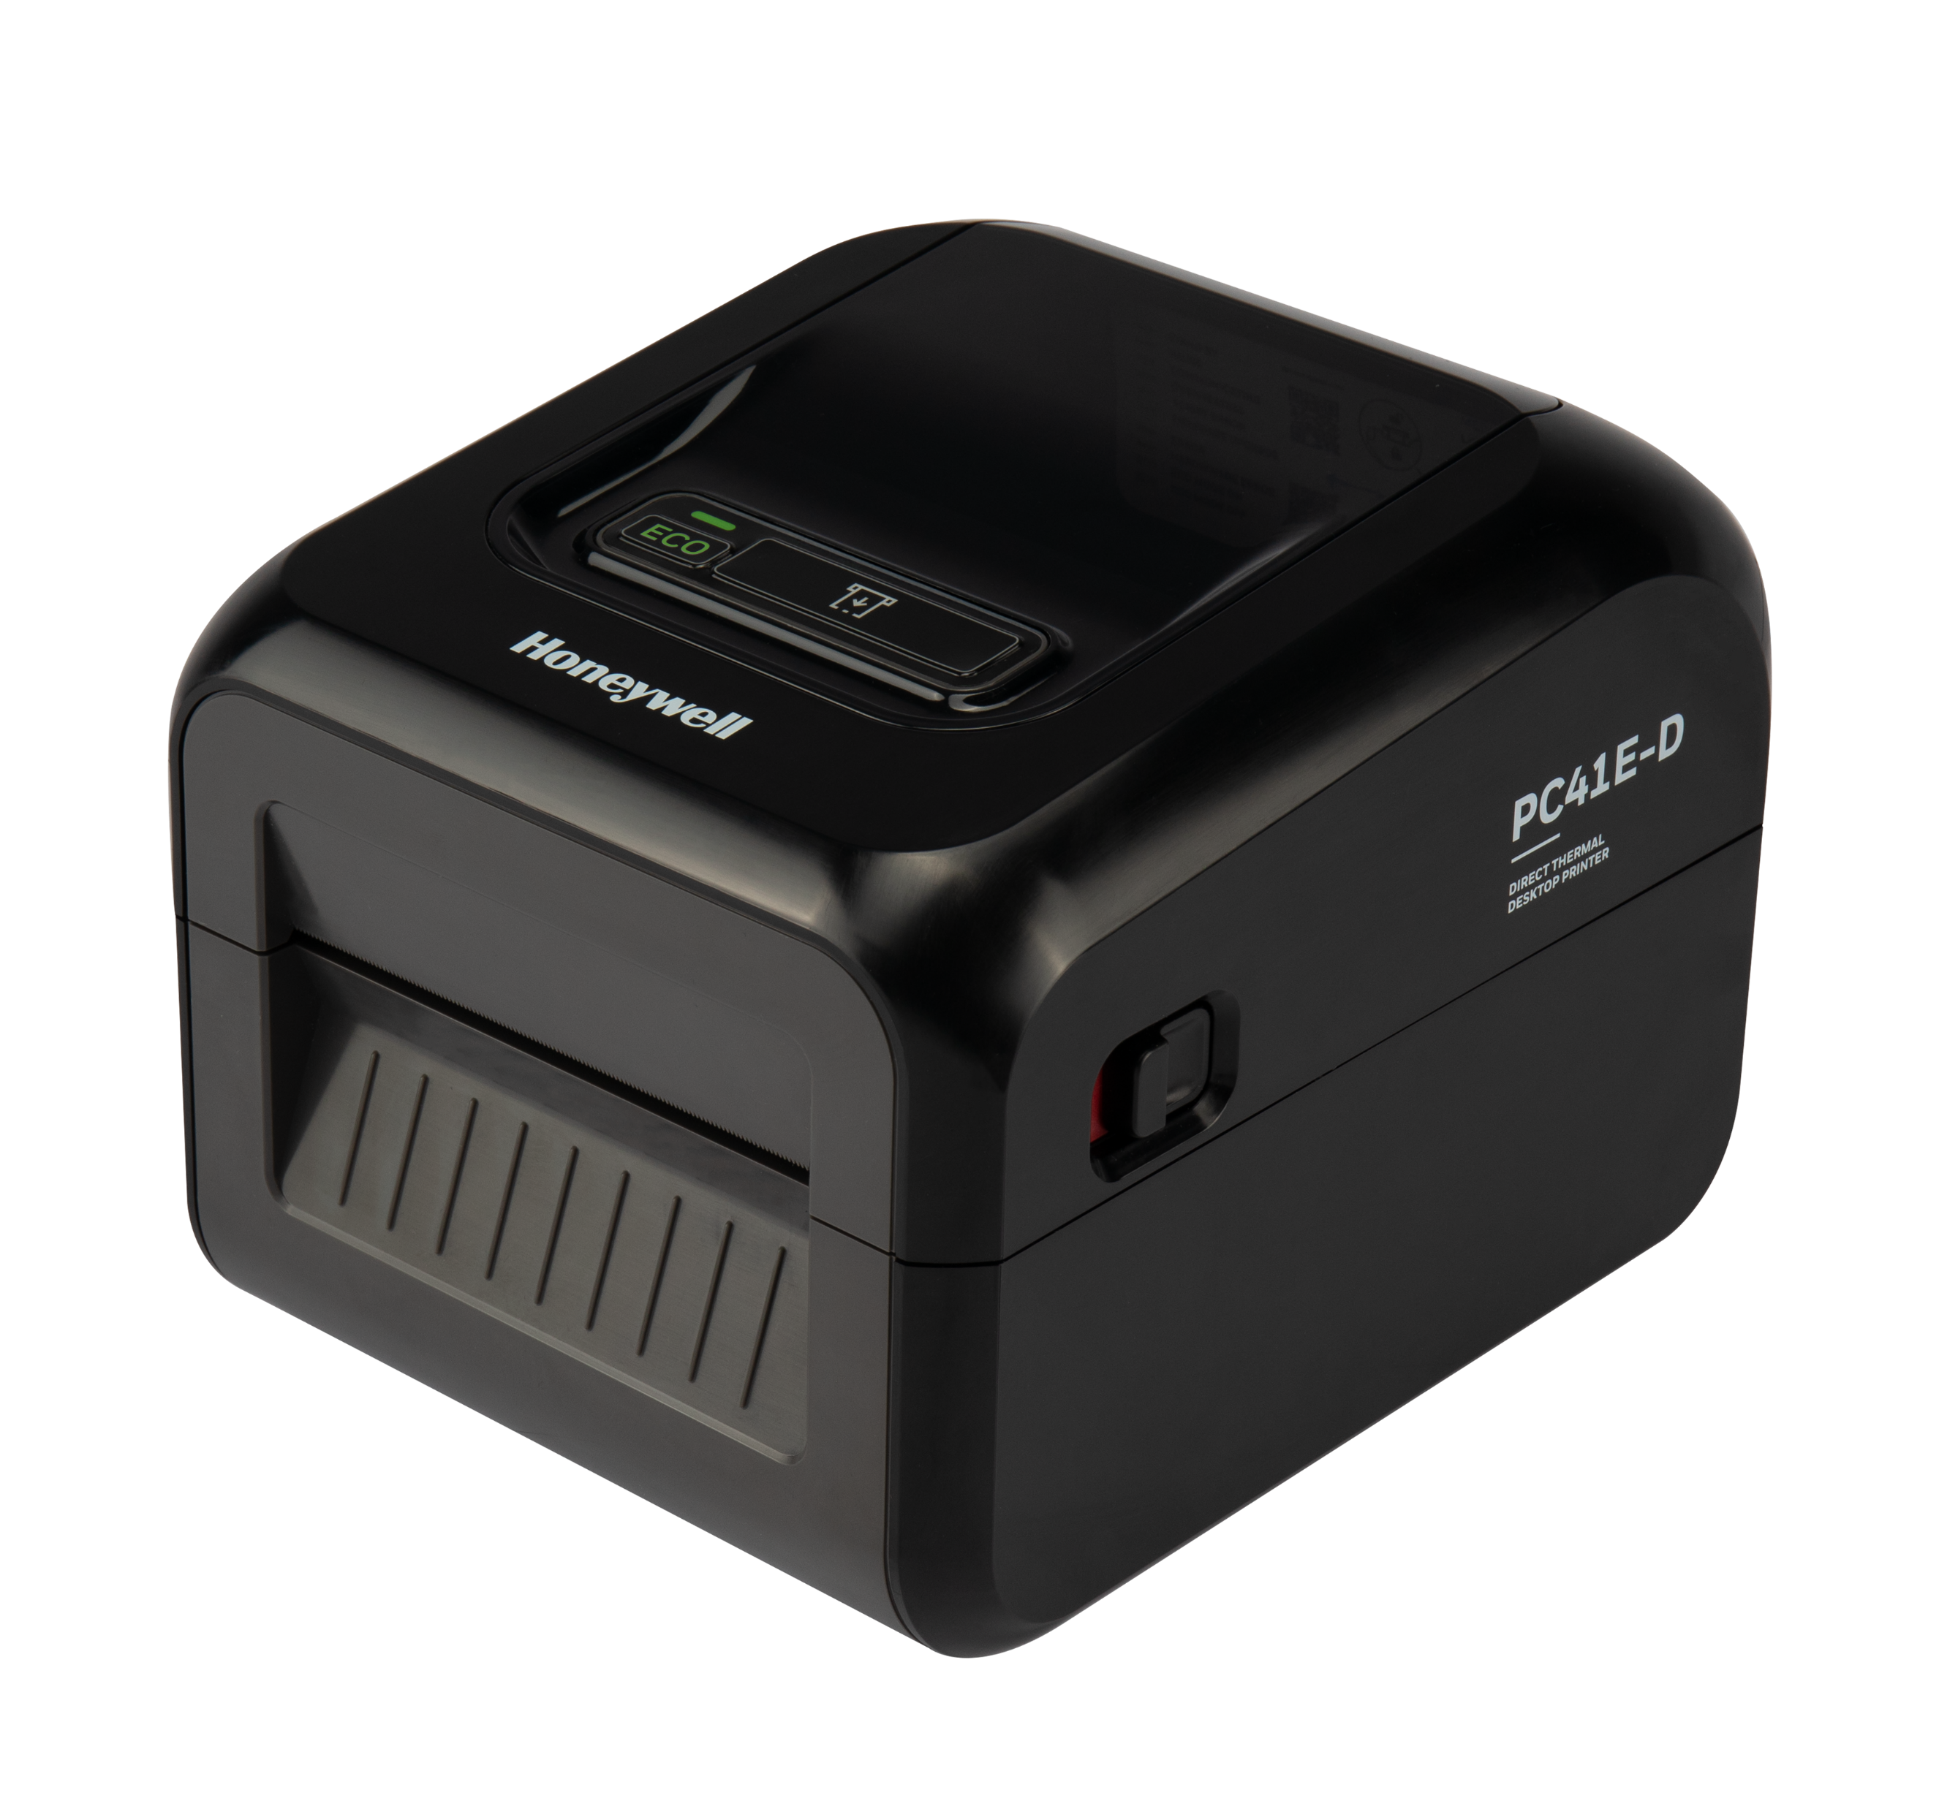
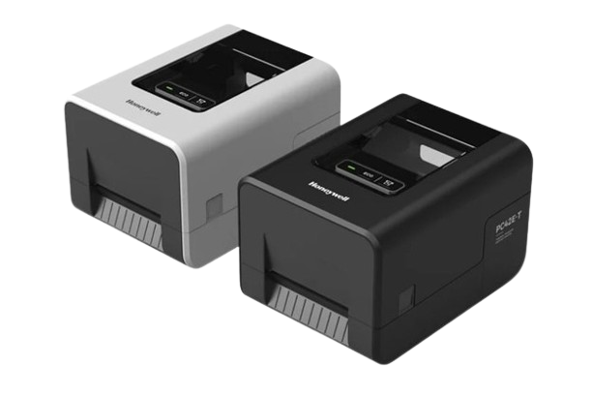
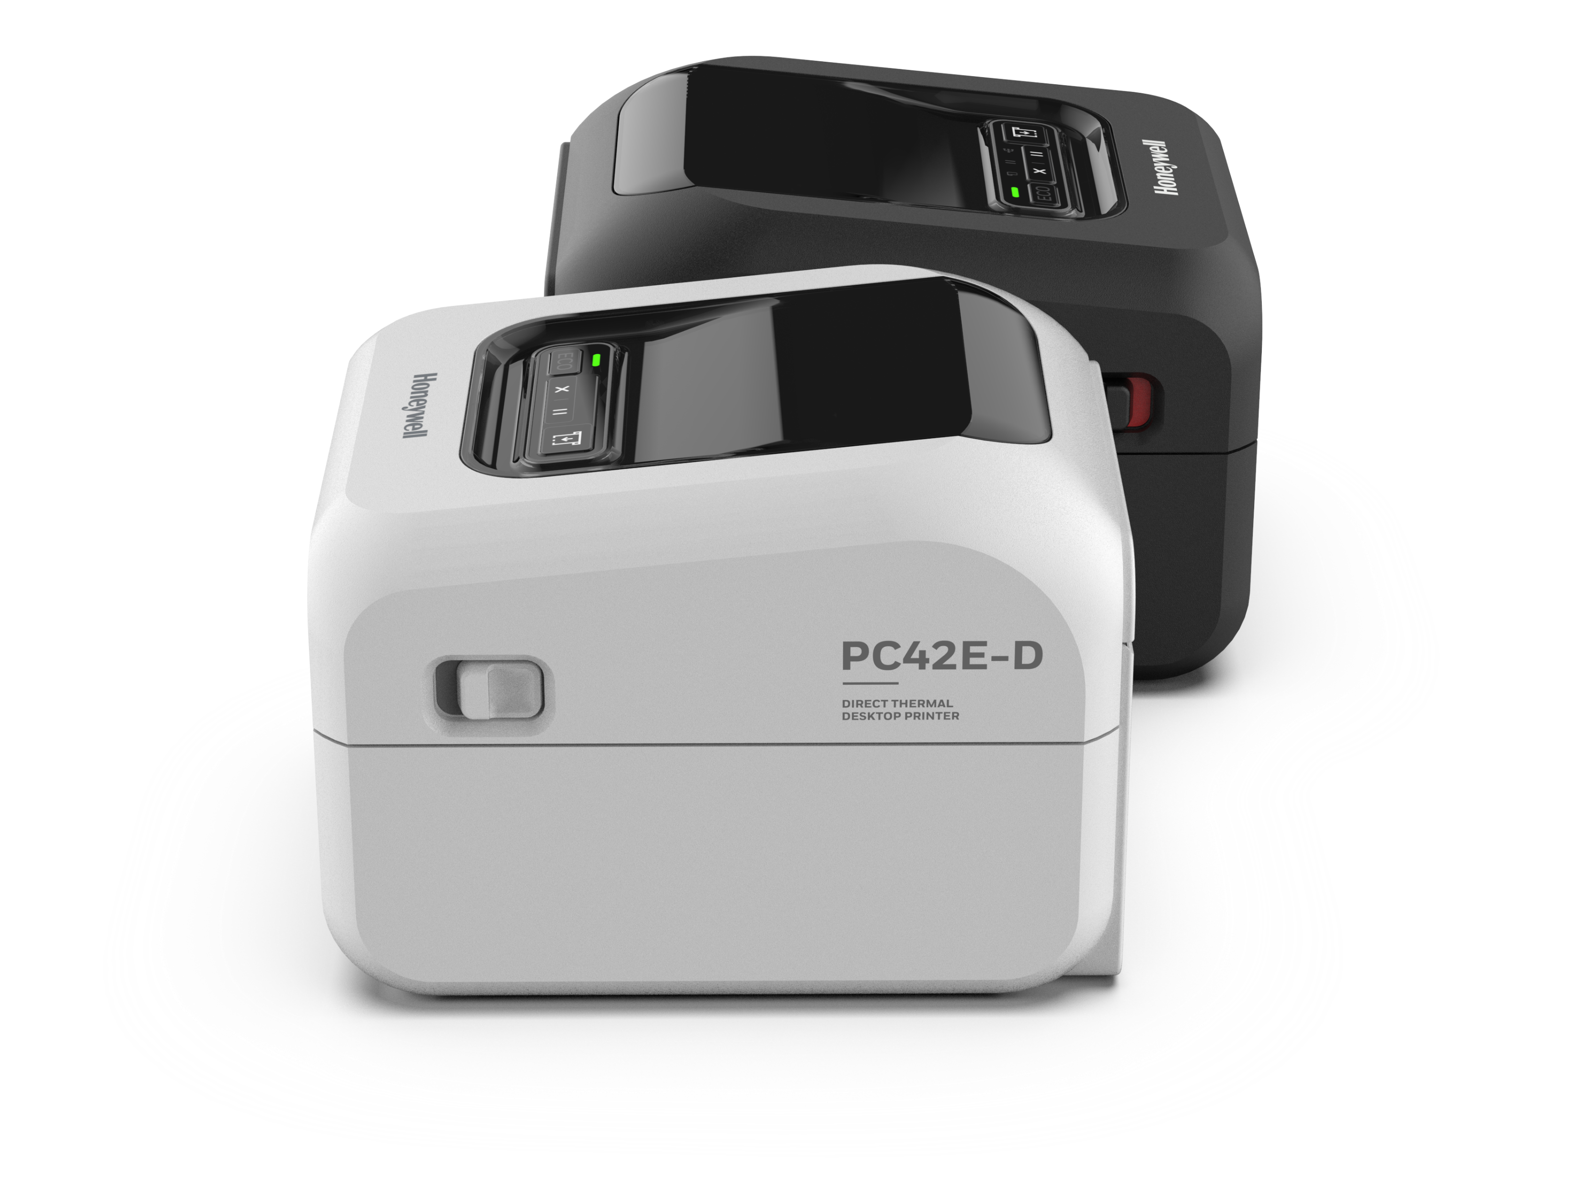
Quick reference guide
PC41E-D, PC42E-T, PC42E-D SERIES
MODEL | PC41E-D |  | PC42E-T |  |  | PC42E-D
POSTIONING | Entry Level |  | Entry Level |  |  | Entry/Mid Level
Key Benefits and Features | Budget Friendly ● Compact ● Fast Printing High Resolution ● Simple to Install |  | Budget Friendly ● High Resolution ● Connectivity Upgrades Multiple Accessories ● Color Options ● Simple to Install |  |  | Budget Friendly ● Compact ● Fast Printing ● High Resolution Robust Storage ● Connectivity Upgrades ● Multiple Accessories ● Low Media Sensing Model Color Options ● Simple to Install
Print Technology | Direct Thermal ● No Ribbon Needed |  | Thermal Transfer ● Ribbon Required |  |  | Direct Thermal ● No Ribbon Needed
Label Requirement | Short Duration Required |  | Long Lasting Harsh Environments, Diverse Label Material, Fade Resistant |  |  | Short Duration Required
Primary Vertical | Retail & E-Commerce | TWL/Parcel/Postal | Retail | TWL | Light Manufacturing | Retail & E-Commerce | TWL/Parcel/Postal
Primary Applications (but not limited to) | Receipt Printing Click & Collect Price Mark-Down & Promos POS Perishable Food/Scale Items | Shipping Receiving POD/Returns | Color Branding Long-term Shelf Labeling Asset Tracking Inventory tags Cold /Hot storage | Picking/Packing Inventory Mgt Cold Storage Outdoor Storage | Asset Tracking Compliance/Safety Inventory Product Label UL Labeling | Receipt Printing Click & Collect Price Mark-Down & Promos POS Perishable Food/Scale Items | Shipping Receiving POD/Returns
Labels per Day (up to) | 1,000 |  | 1,000 |  |  | 1,000
User Interface | 1-Button ● 1-Led |  | 1-Button ● 1-Led |  |  | Multi Led ● Multi Button
Memory | 128 MB |  | 128 MB |  |  | 256 MB
Maximum Print Speed | 203dpi:up to 8ips ● 300dpi:up to 6ips |  | 203dpi:up to 6ips ● 300dpi:up to 5ips |  |  | 203dpi:up to 8ips ● 300dpi:up to 6ips
Resolution | 203dpi (8 dots/mm) ● 300dpi (12 dots/mm) |  | 203dpi (8 dots/mm) ● 300dpi (12 dots/mm) |  |  | 203dpi (8 dots/mm) ● 300dpi (12 dots/mm)
Maximum Print Width | 4.25 in (108 mm) |  | 4.25 in (108 mm) |  |  | 4.25 in (108 mm)
Standard Connectivity | USB |  | Standard USB ● Ethernet |  |  | USB ● Ethernet ● Serial
Optional Connectivity | None |  | Wi-Fi/BT module ● Serial |  |  | Wi-Fi/BT module
Accessories | Printheads ● Platen Rollers ● Power Cords |  | Printheads ● Platen Rollers ● Power Cords ● Cutter Peeler |  |  | Printheads ● Platen Rollers ● Power Cords ● Cutter Peeler
Color Scheme Options | Black Only |  | Black or White |  |  | Black or White
Dimensions | 222.5mm x 184mm x 174mm |  | 273mm x 198mm x 168 mm |  |  | 222.5mm x 184mm x 174mm
Low Media Sensor Configuration | No |  | No |  |  | Yes
*See product datasheet for full product specification, options and accessories.
Notes:
Do I need to add BLE?
Do we need to add Mfi?

