Slide 1
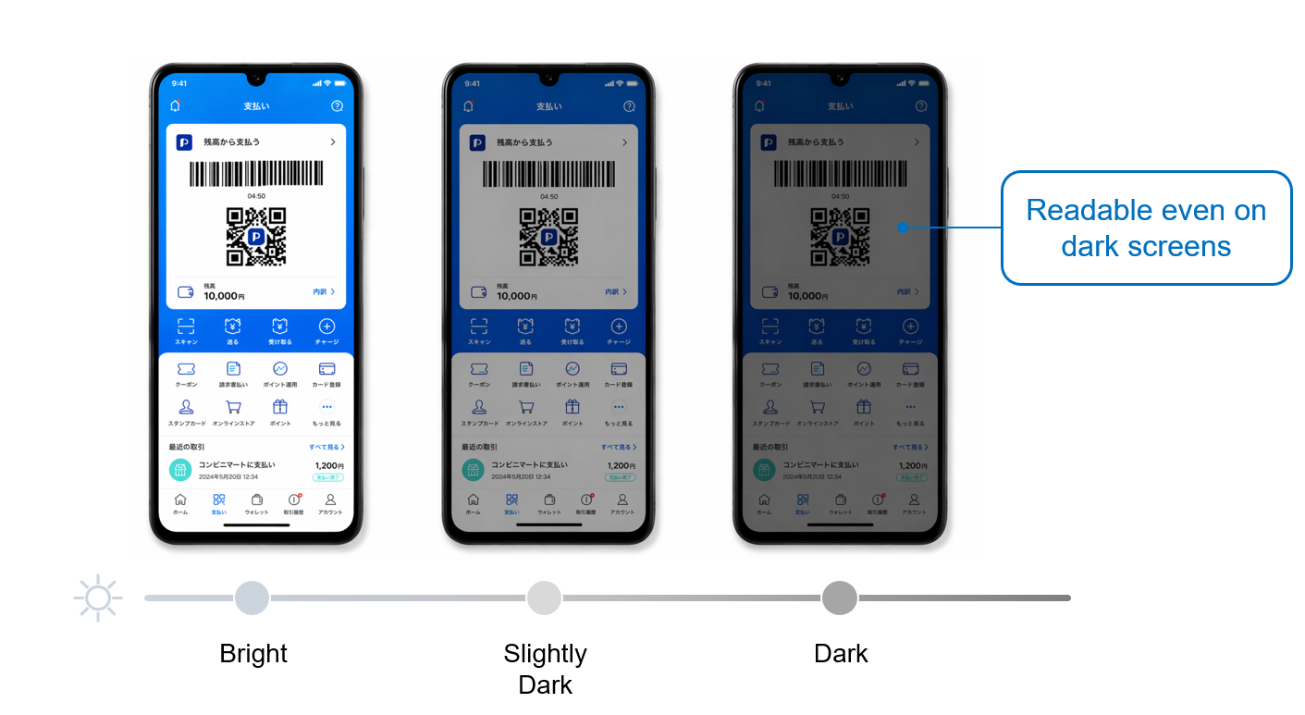
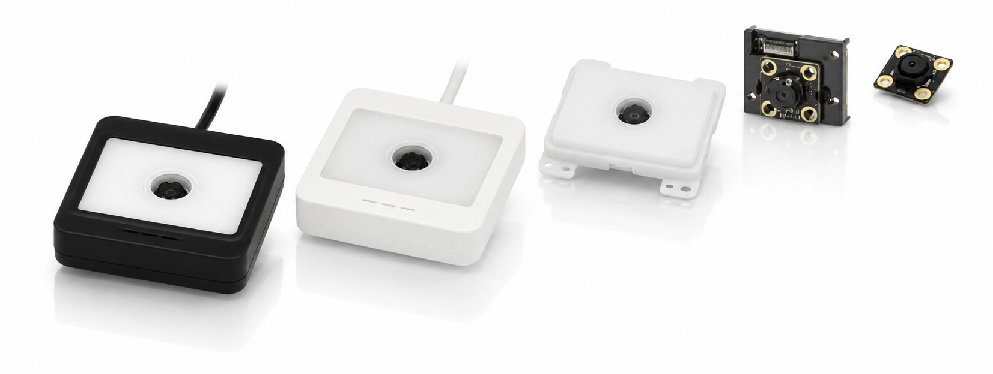
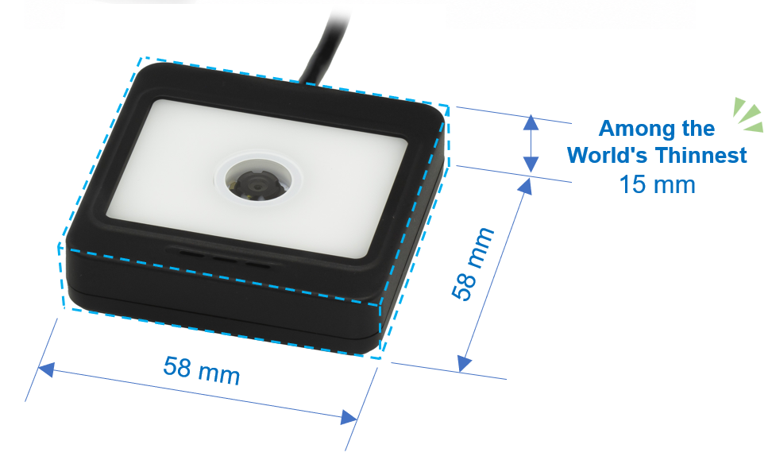
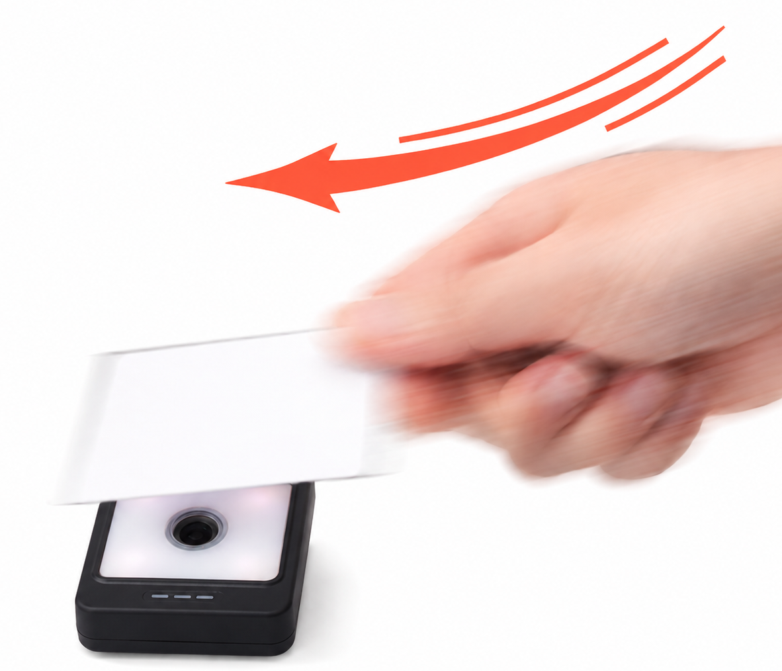

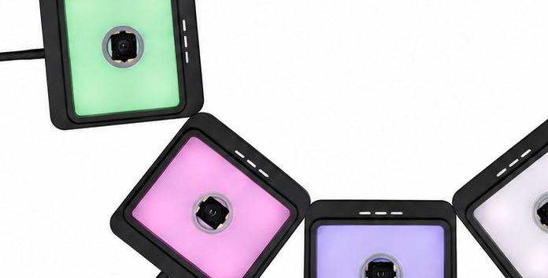
M-12 Series
Motion Tolerance
IP65
Operating temp -20 to 60 ºC
Supports movement speeds up to 3 m/sec *.
Ideal for scanning codes while walking, such as at entrance gates.
* Paper mode, UPC (resolution 0.33 mm)
Full-color LED-equipped, indicator light color configurable.
Customize to match your usage scenario or operational requirements.

